Slide 1
Bank Management System
(Major Project Presentation)
by
Priyanshu Raj SBU200091
Mayank Raj SBU200159
Programme:B.Tech(CSE)
Semester: 8th
Under the Guidance of
Prof. Vivek Kumar
Sarala Birla University, Ranchi

Slide 2
Presentation Outlines
Chapter 1 Introduction
Chapter 2 Importance of Bank Management System
Chapter 3 How Bank management system works?
Chapter 4 Benefits of Bank Management system
Chapter 5 Conclusion and Future Scope
References

Slide 3
Introduction To Bank Management System
A Bank Management System is a computerized system designed to streamline and automate various operations within a bank.
It serves as a comprehensive software solution that facilitates the efficient management of banking processes, customer accounts, transactions, and related operations.
The primary goals of a Bank Management System include accuracy, security, and improved customer service

Slide 4
Why are Bank Management system important?
Bank management system can provide instant and personalized customer support, reducing the need for human visiting physically.
They are available 24/7, allowing users to access information or services at any time.
Bank management system can handle multiple user simultaneously, providing fast and efficient assistance.

Slide 5
How do Bank Management System work?
User Authentication:
Users, including bank staff and customers, need to authenticate themselves through secure login credentials.
Authentication ensures that only authorized individuals have access to the system.
Account Management:
Customers can create new accounts, update account information, or close accounts as needed.
The system maintains a database of customer details, including personal information and account balances.

Slide 6
How do Bank Management System work?
Transaction Processing:
Customers can perform various transactions such as deposits, withdrawals, fund transfers, and payments.
Each transaction is recorded in the system, updating account balances accordingly.
Record Keeping:
The system maintains a detailed record of all transactions, including date, time, and transaction type.
This record serves as an audit trail for tracking and monitoring activities.

Slide 7
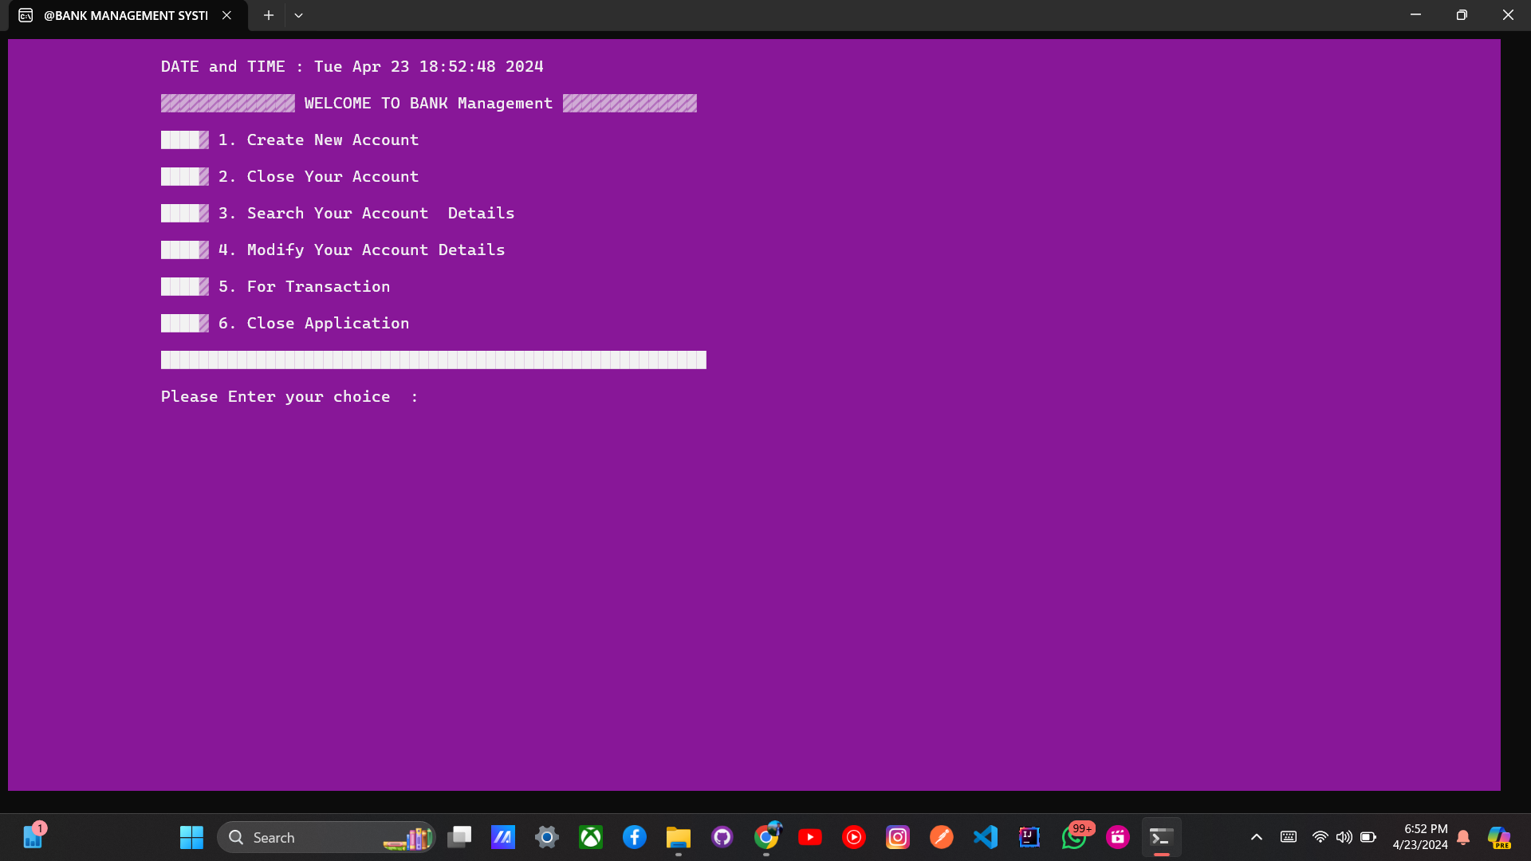

Slide 8
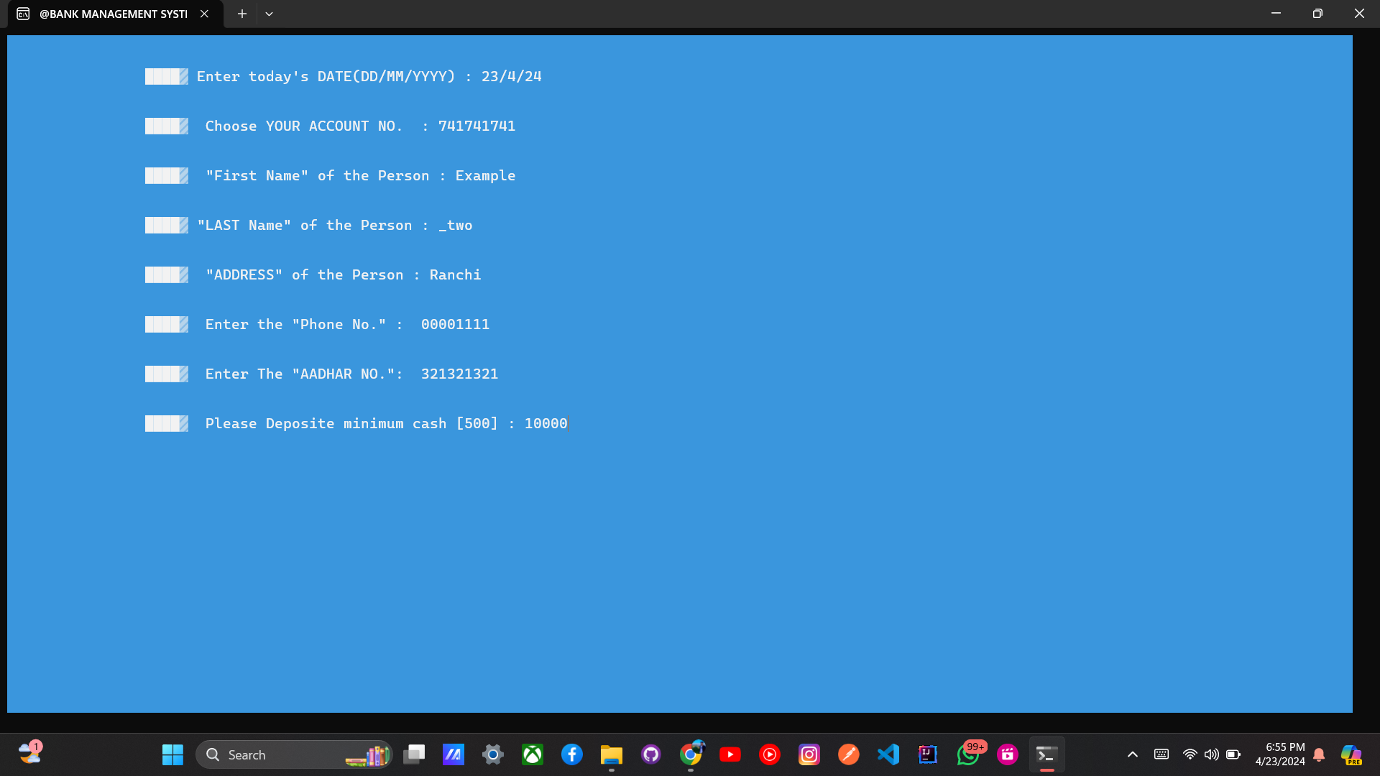

Slide 9
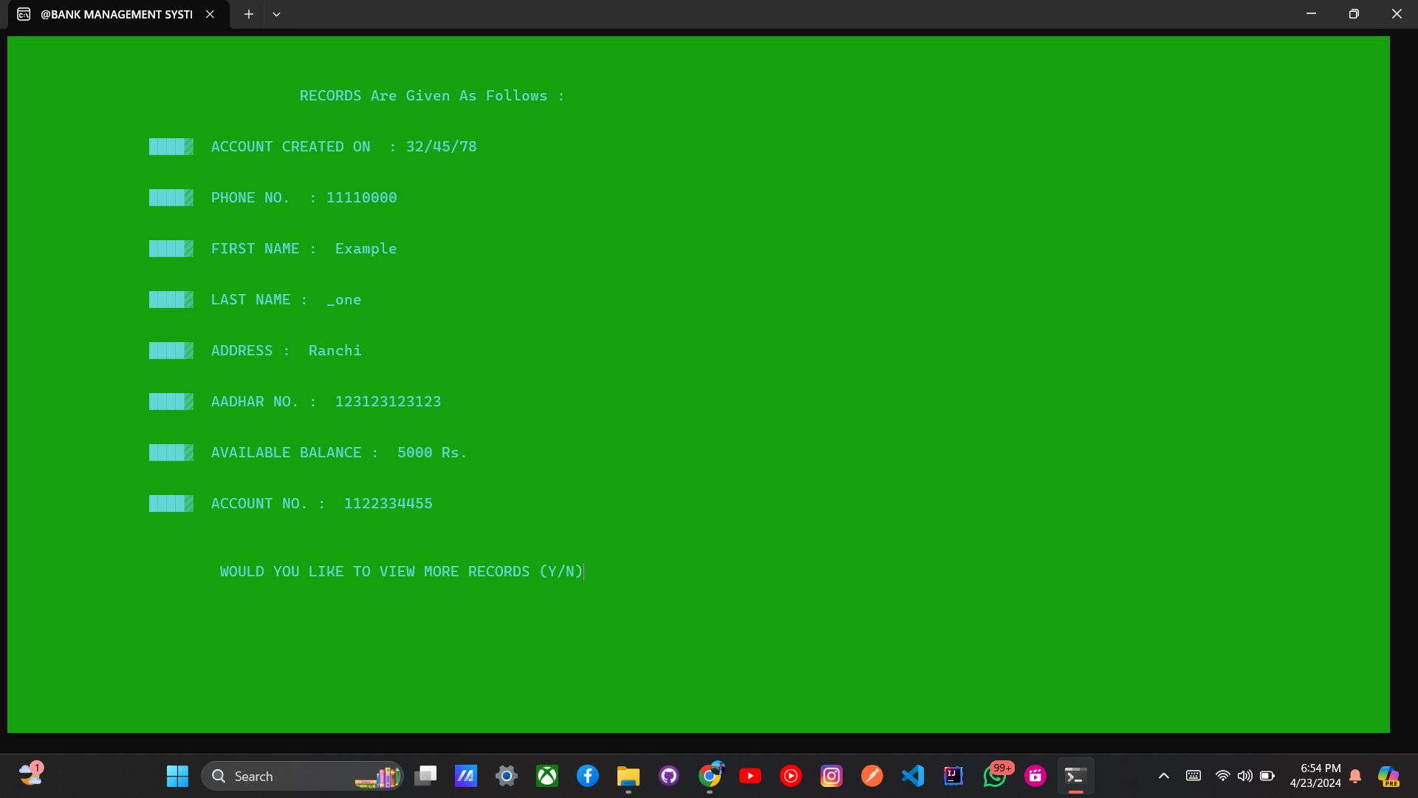

Slide 10
Benefits of Bank Management System:
Efficiency: Streamlines operations, leading to faster transaction processing.
Accuracy: Reduces manual errors in account management and transactions.
Customer Service: Provides convenient access to services, enhancing customer satisfaction.
Security: Implements robust measures to safeguard sensitive financial data.
Transaction Monitoring: Enables tracking for fraud detection and security.

Slide 11
Benefits of Bank Management System:
Record Keeping: Maintains organized records for efficient auditing and compliance.
Resource Optimization: Optimizes human and technological resources.
Data Management: Facilitates effective reporting and analytics for decision-making.
Adaptability: Integrates with new technologies, ensuring competitiveness.
Cost Savings: Reduces operational costs through automation and efficiency.

Slide 12
Application of Bank Management system
Account Management:
Creation, modification, and deletion of customer accounts.
Management of account details, including personal information and account balances.
Transaction Processing:
Facilitation of various transactions, such as deposits, withdrawals, fund transfers, and payments.
Customer Relationship Management (CRM):
Organization and management of customer data, enhancing customer service and relationship building.
Security and Fraud Detection:
Implementation of security measures to protect sensitive data.
Detection and prevention of fraudulent activities through transaction monitoring.
Record Keeping:
Maintenance of a detailed record of all transactions for auditing and compliance purposes.

Slide 13
Future scope of Bank Management System
Advanced Technology Integration:
Implementing artificial intelligence, machine learning, and blockchain for enhanced security and efficiency.
Biometric Authentication:
Increasing use of fingerprint and facial recognition for secure and user-friendly access.
Mobile and Contactless Payments:
Continued growth in mobile banking and contactless payment options.
Open Banking:
Encouraging collaboration and innovation by allowing third-party developers to create new financial services.

Slide 14
Conclusion
The project had three main goals:
1.Create an algorithm for Bank management system.
2.Build a database to store relevant information.
3.Develop a user-friendly interface for regular users.
In conclusion,
A Bank Management System stands as a pivotal tool in the dynamic
landscape of the financial industry. It serves as the technological backbone
that not only streamlines and automates intricate banking processes but also
ensures a secure, efficient, and customer-centric environment.

Slide 15
References :
ChatGPT : https://chat.openai.com/
YouTube : https://www.youtube.com/
Examples : https://botexamples.com/
Mdn Docs : https://devdocs.io/c/
Gfg : https://www.geeksforgeeks.org/bank-account-system-in-c-using-file-handling/
WotNot : https://www.youtube.com/@WotNot-io

Slide 16
Thanks

